Slide 1
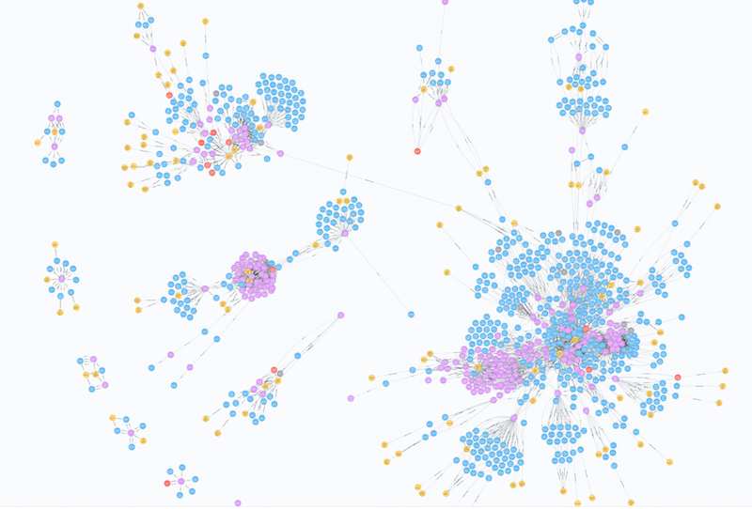
Composition of Foods: Raw, Processed, Prepared Report of building up Knowledge Graph
Designed by Davidddl

Slide 2
Number of Records in Content
DataName | FileName | DataNum
Food Description | FOOD_DES | 7793
Nutrient Data | NUT_DATA | 644125
Household Weights and Measures | WEIGHT | 14449
Footnote | FOOTNOTE | 537

Slide 3
Number of Records in Support
DataName | FileName | DataNum
Food Group Description | FD_GROUP | 25
Langual Factors | LANGUAL | 37910
Langual Factors Description | LANGDESC | 773
Nutrient Definitions | NUTR_DEF | 149
Source Code | SRC_CD | 10
Data Derivation Code Des | DERIV_CD | 56
Sources of Data Link | DATSRCLN | 228457
Sources of Data | DATA_SRC | 606

Slide 4
Data Relationship
Food Description File
NDB No.
Food Group Code
Food Group Description File
Food Group Code
Footnote File
NDB No.
Nutrient Data File
NDB No.
Nutrient No.
Source Code
Derivation Code
Weight File
NDB No.
Langual Factor File
NDB No.
Factor Code
Nutrient Definition File
Nutrient No.
Source Code File
Source Code
Data Derivation Code Description File
Data Derivation Code
Source of Data Link File
NDB No.
DataSrc ID
Sources of Data File
DataSrc ID
Langual Factors Description File
Factor Code

Slide 5
Explanation of Food Description File
The Food Description file contains long and short descriptions and food group designators for all food items, along with common names, manufacturer name, scientific name, percentage and description of refuse, and factors used for calculating protein and kilocalories, if applicable.
Relationships between the Food Description file and other files:
Links to the Food Group Description file by the FdGrp_Cd field
Links to the Nutrient Data file by the NDB_No field
Links to the Weight file by the NDB_No field
Links to the Footnote file by the NDB_No field
Links to the LanguaL Factor file by the NDB_No field

Slide 6
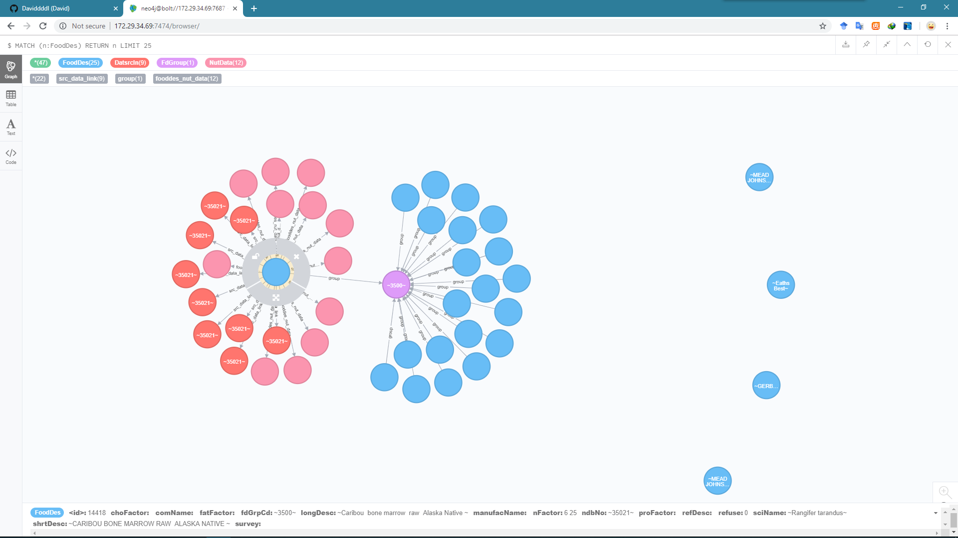
Eg. A FoodDes Node of KG
private String ndbNo;
private String fdGrpCd;
private String longDesc;
private String shrtDesc;
private String comName;
private String manufacName;
private String survey;
private String refDesc;
private String refuse;
private String sciName;
private String nFactor;
private String proFactor;
private String fatFactor;
private String choFactor;

Slide 7
Explanation of Food Group Description File
The Food Group Description file is a support file for the Food Description file and lists the food groups used in this KG and their descriptions.
Relationships between the Food Group Description file and other files:
Links to the Food Description file by FdGrp_Cd

Slide 8
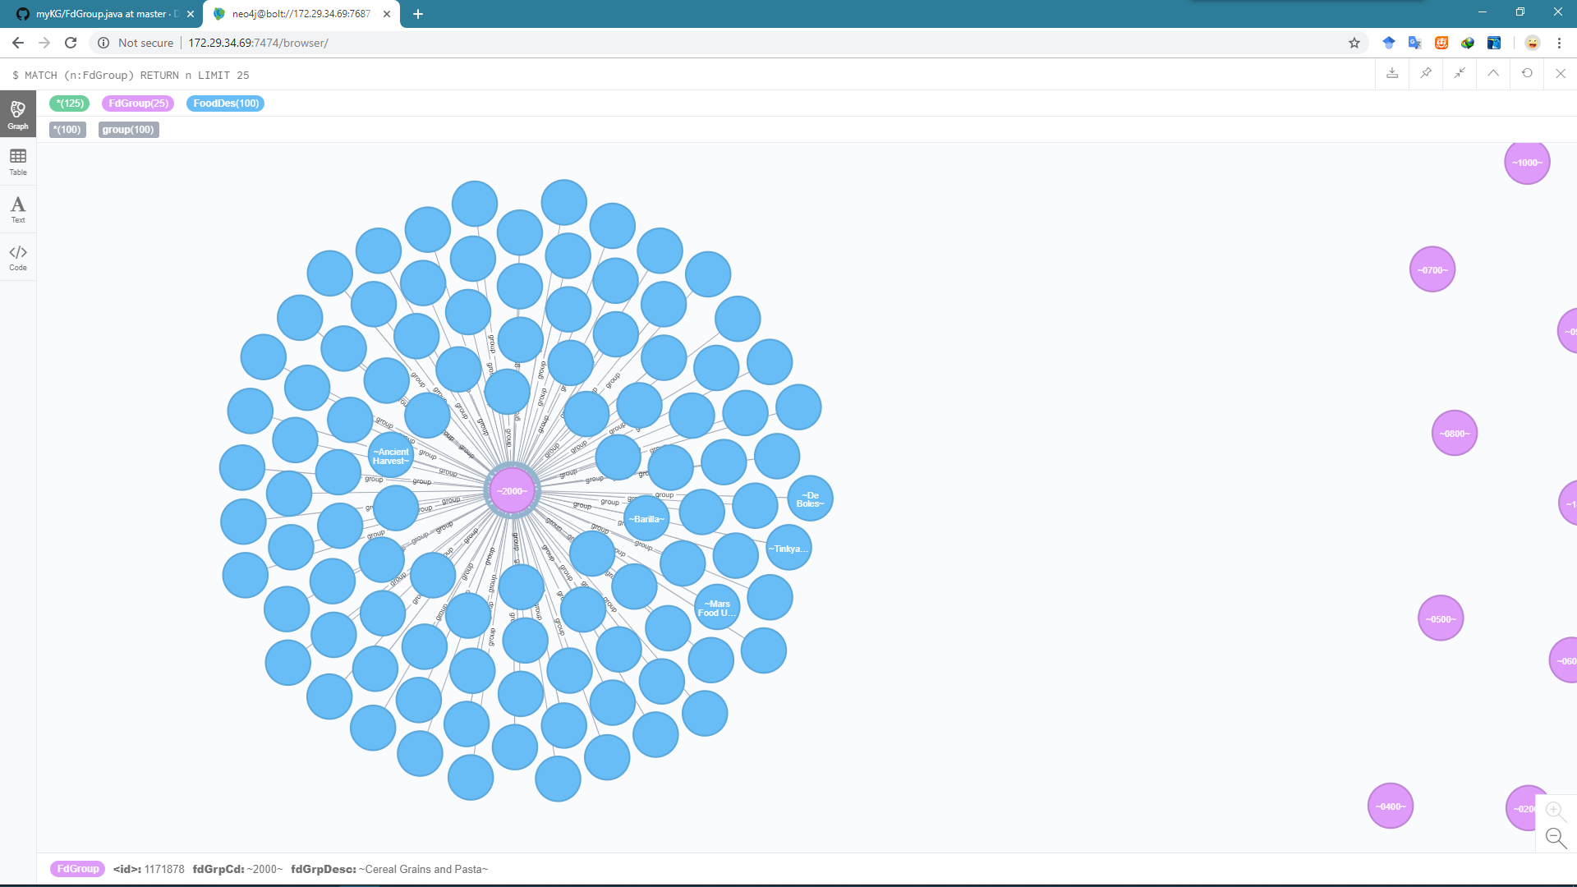
Eg. A FdGroup Node of KG
private String fdGrpCd;
private String fdGrpDesc;

Slide 9
Explanation of Langual Factor File
The LangauL Factors file is a support file for the Food Description file and contains the factors from the LanguaL thesaurus used to code each food.
Relationships between the LanguaL Factors file and other files:
Links to the Food Description file by the NDB_No field
Links to LanguaL Factors Description file by the Factor_Code field

Slide 10
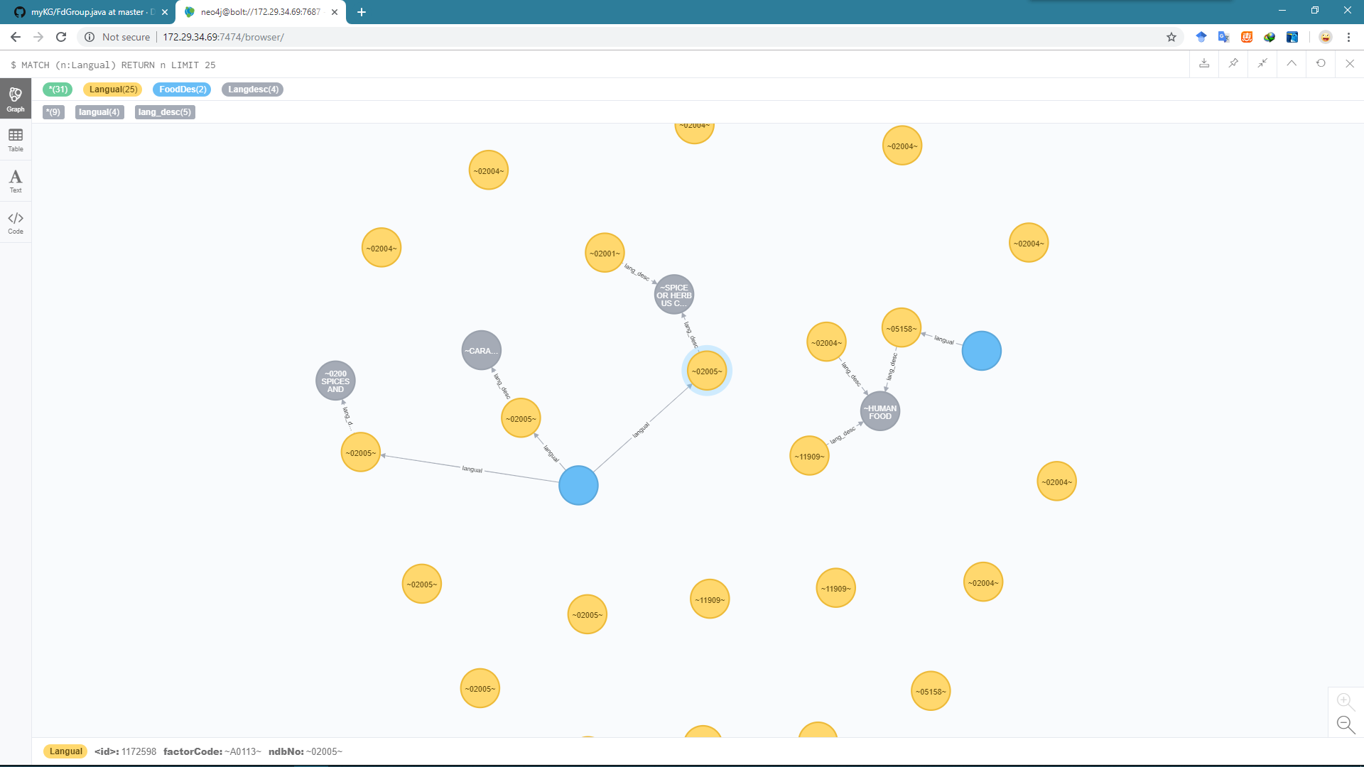
Eg. A Langual Node of KG
private String ndbNo;
private String factorCode;

Slide 11
Explanation of Langual Factor Description File
The LanguaL Factors Description file is a support file for the LanguaL Factor file and contains descriptions of the factors used to assign selected food items codes in KG.
Relationships between the LanguaL Factor Descriptions file and other files:
Links to the LanguaL Factor file by the Factor_Code field

Slide 12
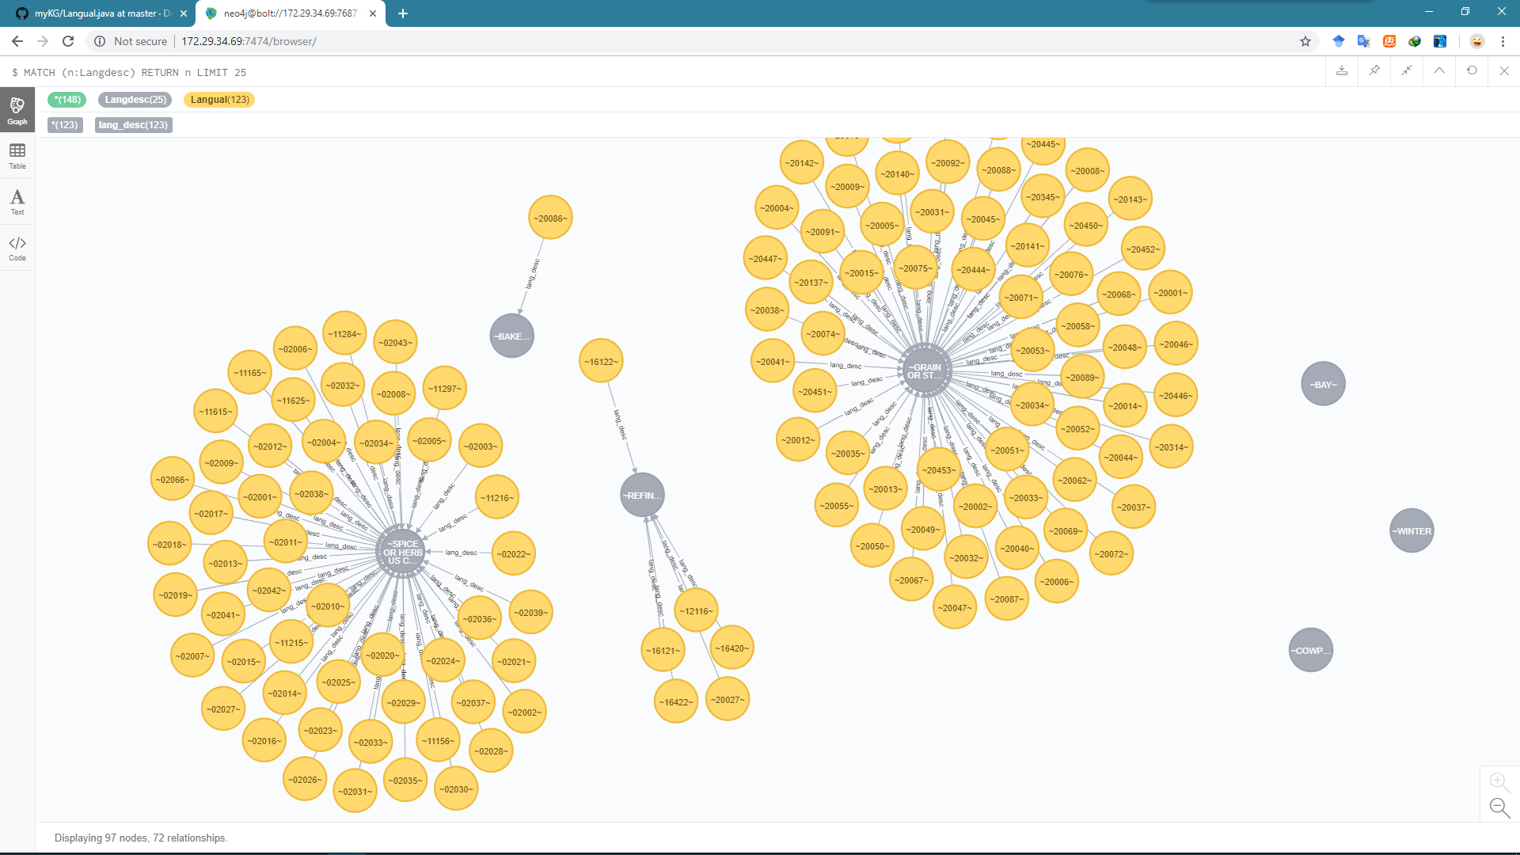
Eg. A Langdesc Node of KG
private String factorCode;
private String description;

Slide 13
Explanation of Nutrient Data File
The Nutrient Data file contains the nutrient values and information about these values, including statistical information.
Relationships between the Nutrient Data Description file and other files:
Links to the Food Description file by NDB_No
Links to the Weight file by NDB_No
Links to the Footnote file by NDB_No and when applicable, Nutr_No
Links to the Sources of Data Link file by NDB_No and Nutr_No
Links to the Nutrient Definition file by Nutr_No
Links to the Source Code file by Src_Cd
Links to the Data Derivation Code Description file by Deriv_Cd

Slide 14
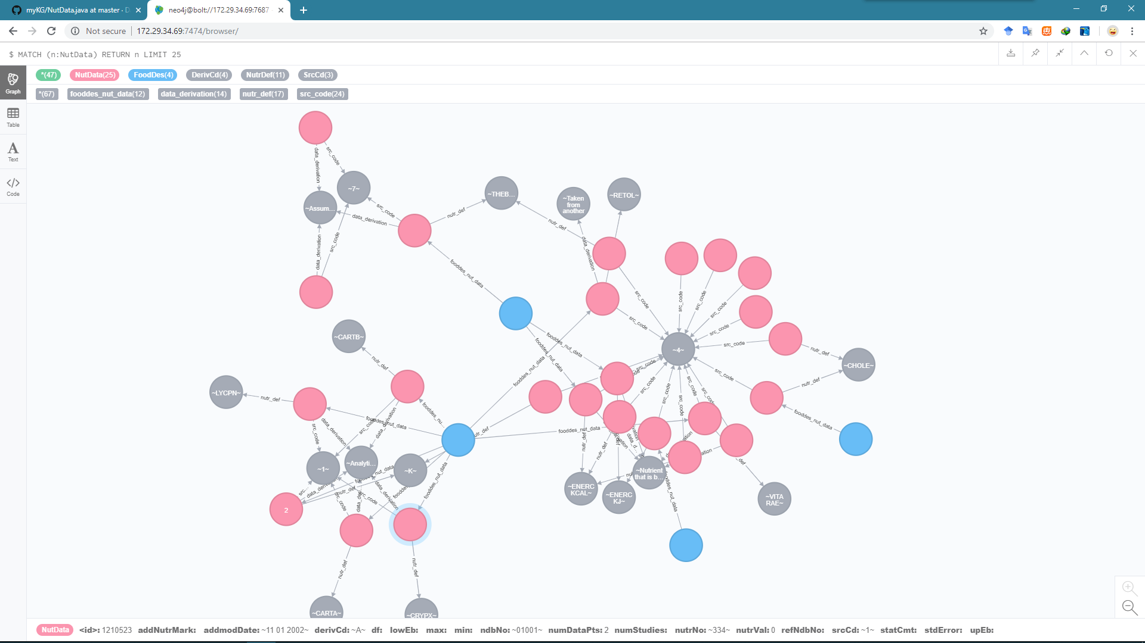
Eg. A NutData Node of KG
private String ndbNo;
private String nutrNo;
private String nutrVal;
private String numDataPts;
private String stdError;
private String srcCd;
private String derivCd;
private String refNdbNo;
private String addNutrMark;
private String numStudies;
private String min;
private String max;
private String df;
private String lowEb;
private String upEb;
private String statCmt;
private String addmodDate;

Slide 15
Explanation of Nutrient Definition File
The Nutrient Definition file is a support file for the Nutrient Data file. It provides the three-digit nutrient code, unit of measure, International Network of Food Data Systems tagname, and description for each nutrient or food component.
Relationships between the Nutrient Definition file and other files:
Links to the Nutrient Data file by Nutr_No

Slide 16
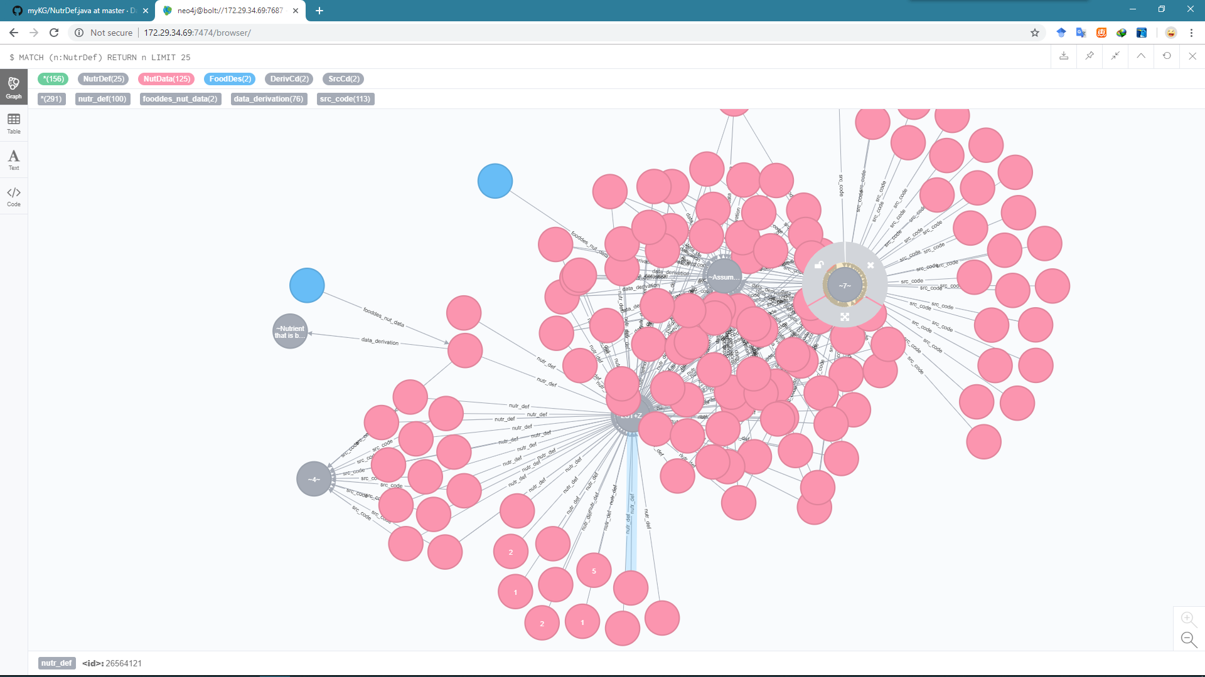
Eg. A NutrDef Node of KG
private String nutrNo;
private String units;
private String tagname;
private String nutrDesc;
private String numDec;
private String srOrder;

Slide 17
Explanation of Source Code File
The Source Code file contains codes indicating the type of data (e.g., analytical, calculated, or assumed zero) in the Nutrient Data file.
Relationships between the Source Code file and other files:
Links to the Nutrient Data file by Src_Cd

Slide 18
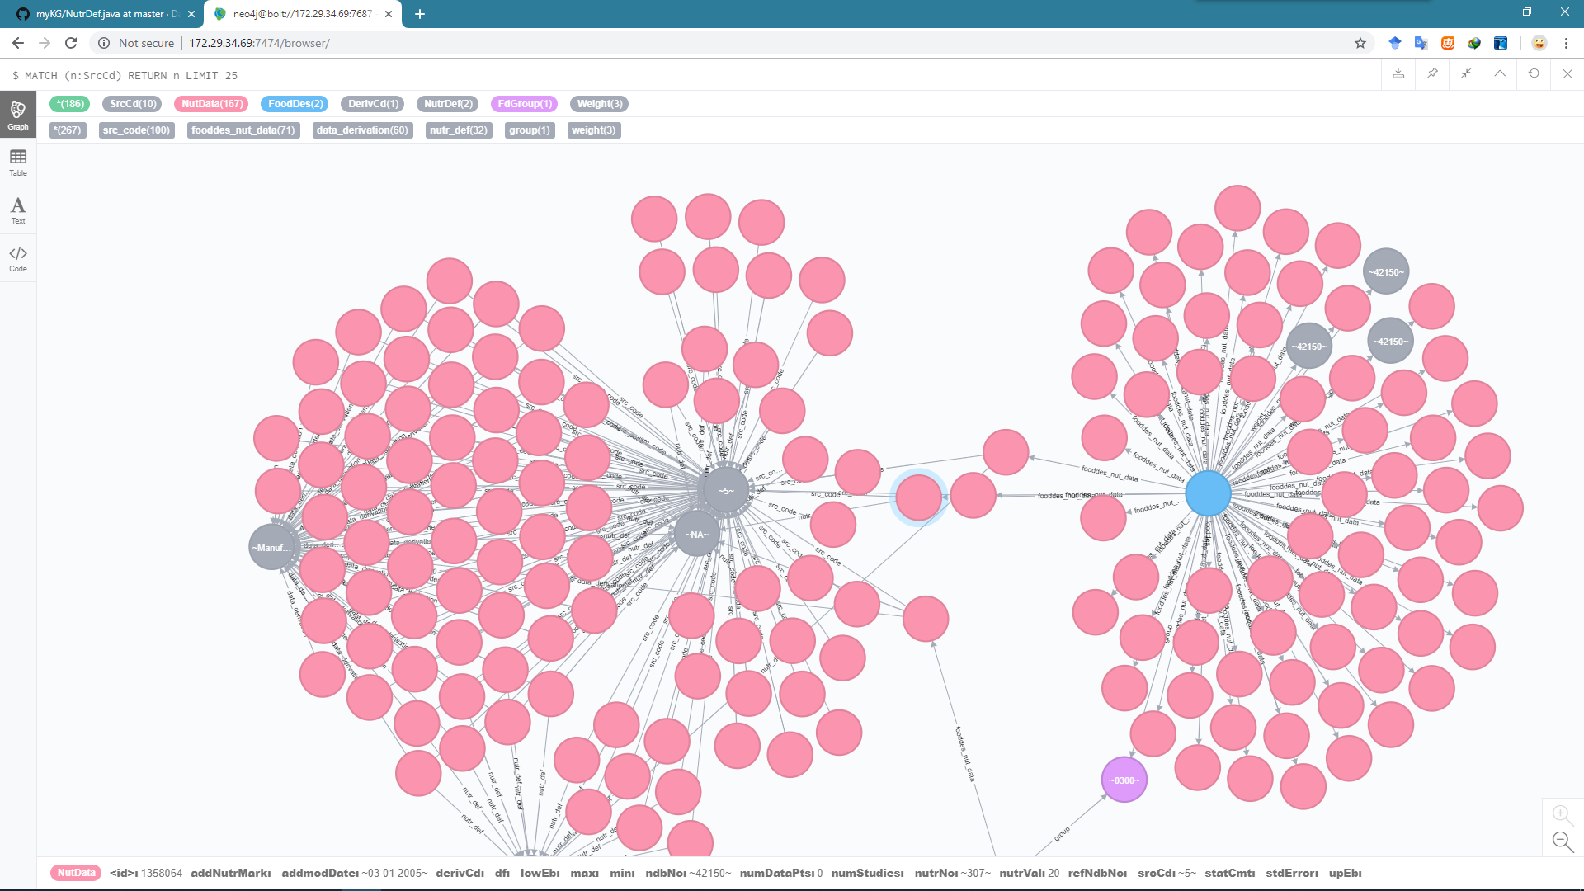
Eg. A SrcCd Node of KG
private String srcCd;
private String srcCdDesc;

Slide 19
Explanation of Data Derivation Code File
The Data Derivation Code file provides information on the derivation codes, and their descriptions.
Relationships between the Data Derivation Code Description file and other files:
Links to the Nutrient Data file by Deriv_Cd

Slide 20
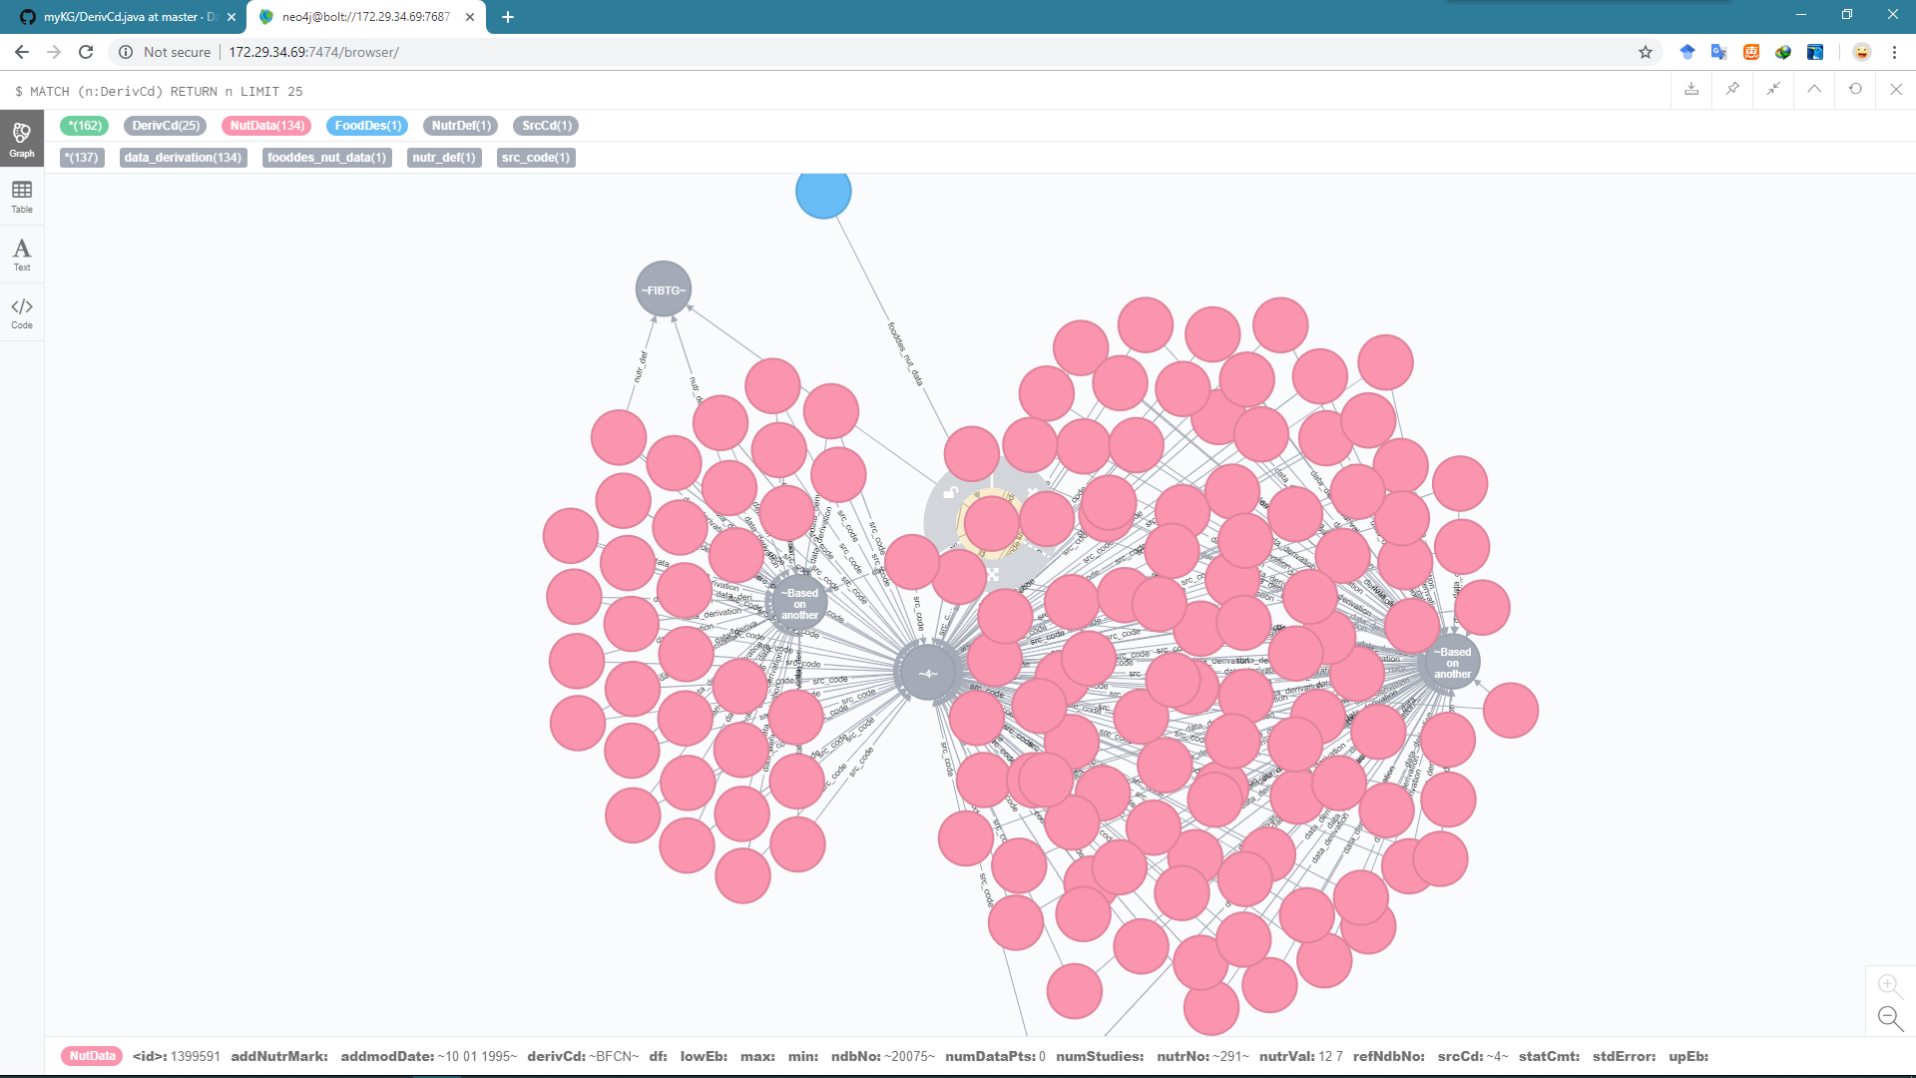
Eg. A DerivCd Node of KG
private String derivCd;
private String derivDesc;

Slide 21
Explanation of Weight File
The Weight file contains the weights in grams of several common measures for each food item.
Relationships between the Weight file and other files:
Links to Food Description file by NDB_No
Links to Nutrient Data file by NDB_No

Slide 22
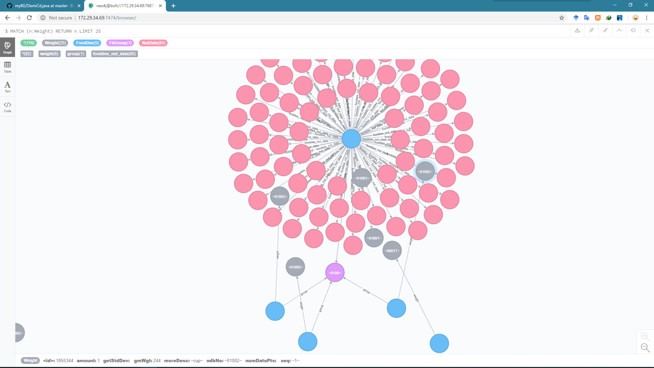
Eg. A Weight Node of KG
private String ndbNo;
private String seq;
private String amount;
private String msreDesc;
private String gmWgt;
private String numDataPts;
private String stdDev;

Slide 23
Explanation of Footnote File
The Footnote file contains additional information about each food item, its household weight and/or nutrient value.
Relationships between the Footnote file and other files:
Links to the Food Description file by NDB_No
Links to the Nutrient Data file by NDB_No and when applicable, Nutr_No
Links to the Nutrient Definition file by Nutr_No, when applicable

Slide 24
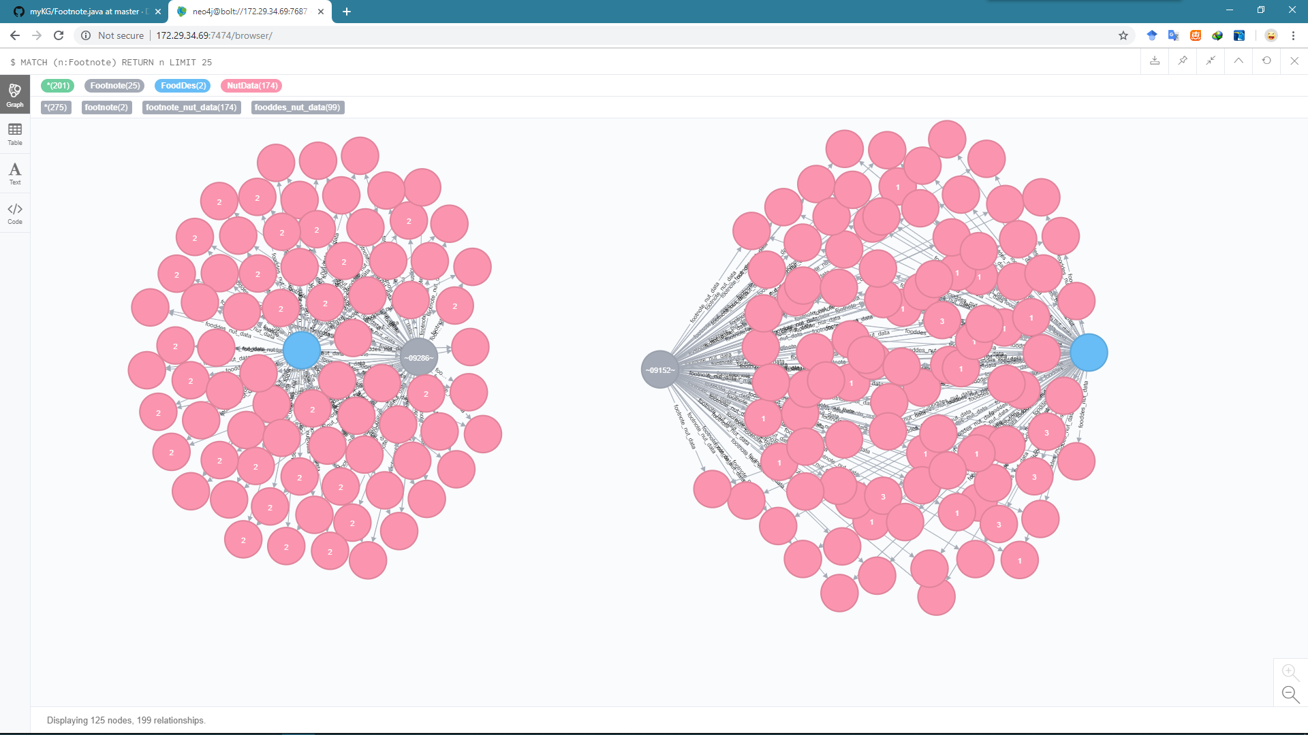
Eg. A Footnote Node of KG
private String ndbNo;
private String footntNo;
private String footntTyp;
private String nutrNo;
private String footntTxt;

Slide 25
Explanation of Sources of Data Link File
The Sources of Data Link file links the Nutrient Data file with the Sources of Data table. It is needed to resolve the many-to-many relationship between the two tables.
Relationships between the Sources of Data Link file and other files:
Links to the Nutrient Data file by NDB No. and Nutr_No
Links to the Nutrient Definition file by Nutr_No
Links to the Sources of Data file by DataSrc_ID

Slide 26
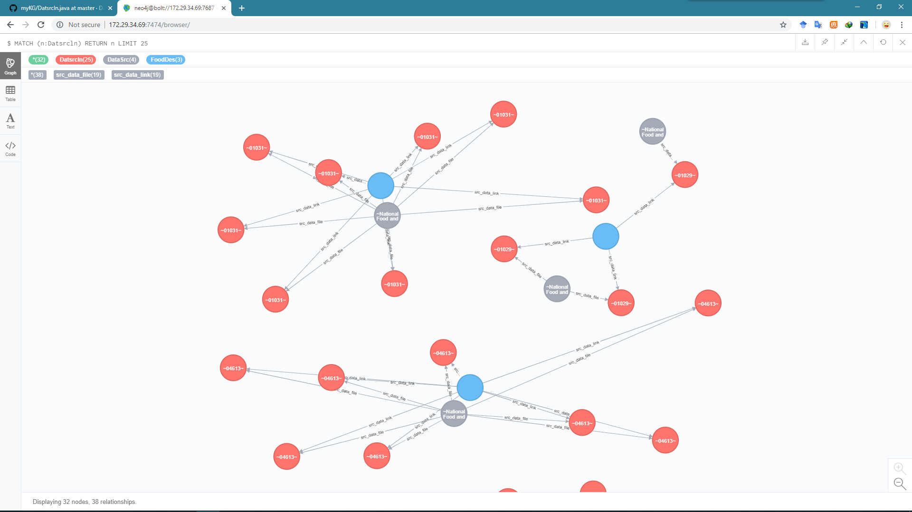
Eg. A Datasrcln Node of KG
private String ndbNo;
private String nutrNo;
private String dataSrcId;

Slide 27
Explanation of Sources of Data File
The Sources of Data file provides a connection to the DataSrc_ID in the Sources of Data Link file.
Relationships between the Sources of Data file and other files:
Links to Nutrient Data file by NDB No. through the Sources of Data Link file

Slide 28
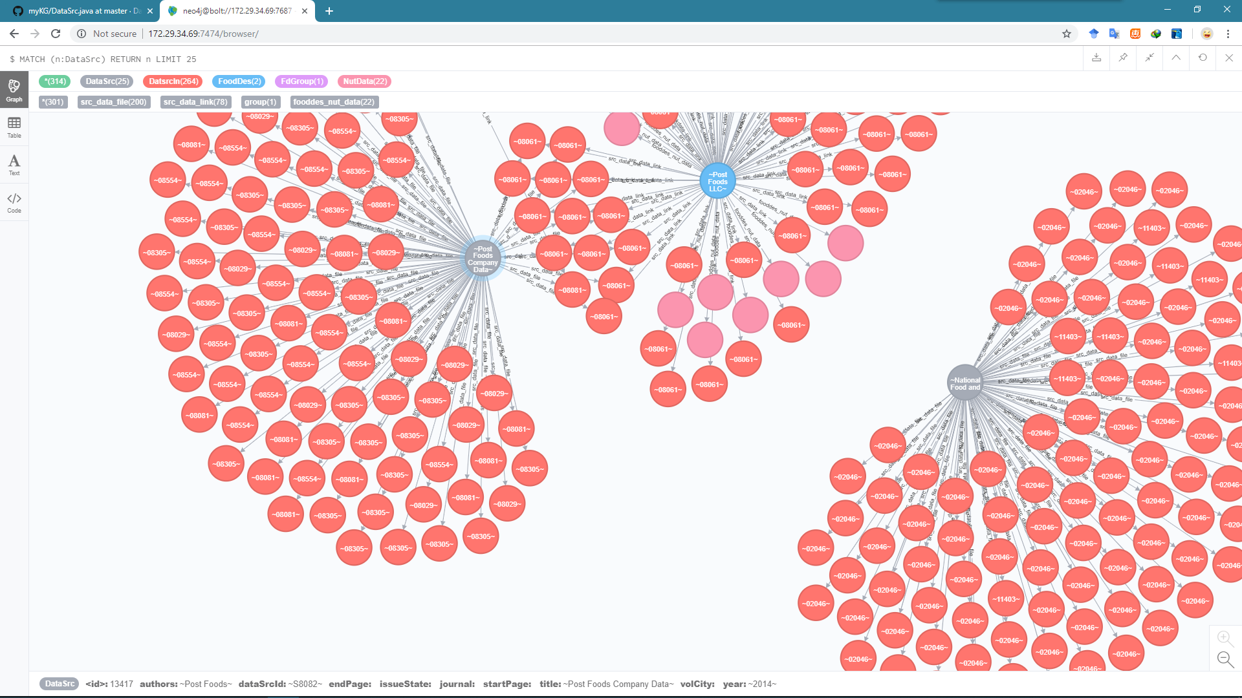
Eg. A DataSrc Node of KG
private String dataSrcId;
private String authors;
private String title;
private String year;
private String journal;
private String volCity;
private String issueState;
private String startPage;
private String endPage;

Slide 29
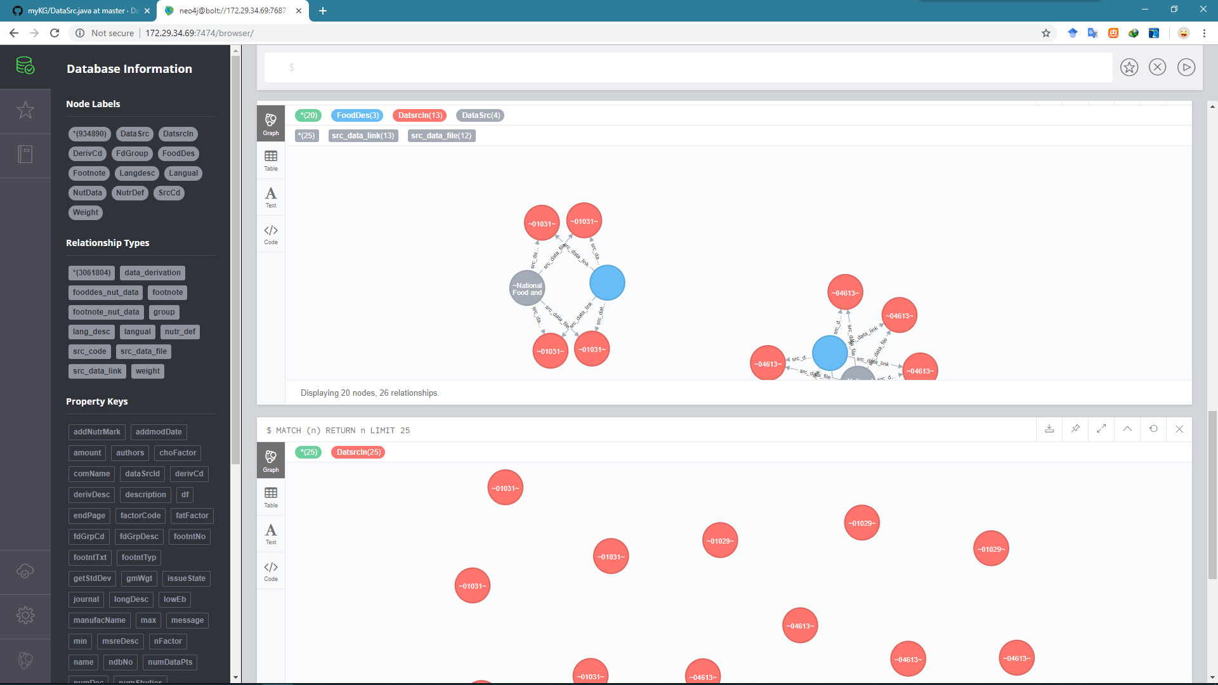
Summary of the KG
Main Page
Node Types: 12
Node Nums: 934890
Relationship Types: 12
Relationship Nums: 3061804
Property Keys: 62
Graph Size: 13.36 GB
Graph Name: foodKG

Slide 30
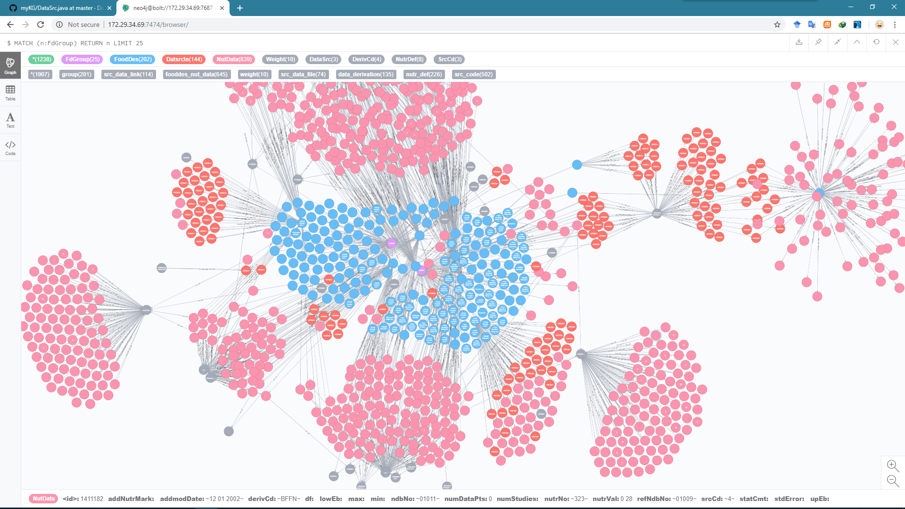
Example Graph
Detail zoom in a sub-graph: Node Details, Relationships, Summary

Slide 31
Introduce of Cypher
Cypher is Neo4j’s open graph query language. Cypher’s syntax provides a familiar way to match patterns of nodes and relationships in the graph.
Eg. Cast of food_Description starting with “Apple”
MATCH (foodD:foodDes)-[:nutrient]->(dataS:dataSrc)
WHERE foodD.title STARTS WITH “Apple“
RETURN foodD.title AS title, collect(foodD.name) AS cast
ORDER BY title ASC LIMIT 10;

Slide 32
Interfaces of backend project
List<HashMap> getNodesByLabels(String label, Integer num, List<String> keys);
List<Map> getRelationsByName(String relationName, Integer num);
HashMap<String, String> getNodeById(String nodeId, List<String> keys);
List<Map> getRelationsOfNodeById(String nodeId, Integer num);
List<Map> findRelationsOfTwoNodes(String nodeId1, String nodeId2);

Slide 33
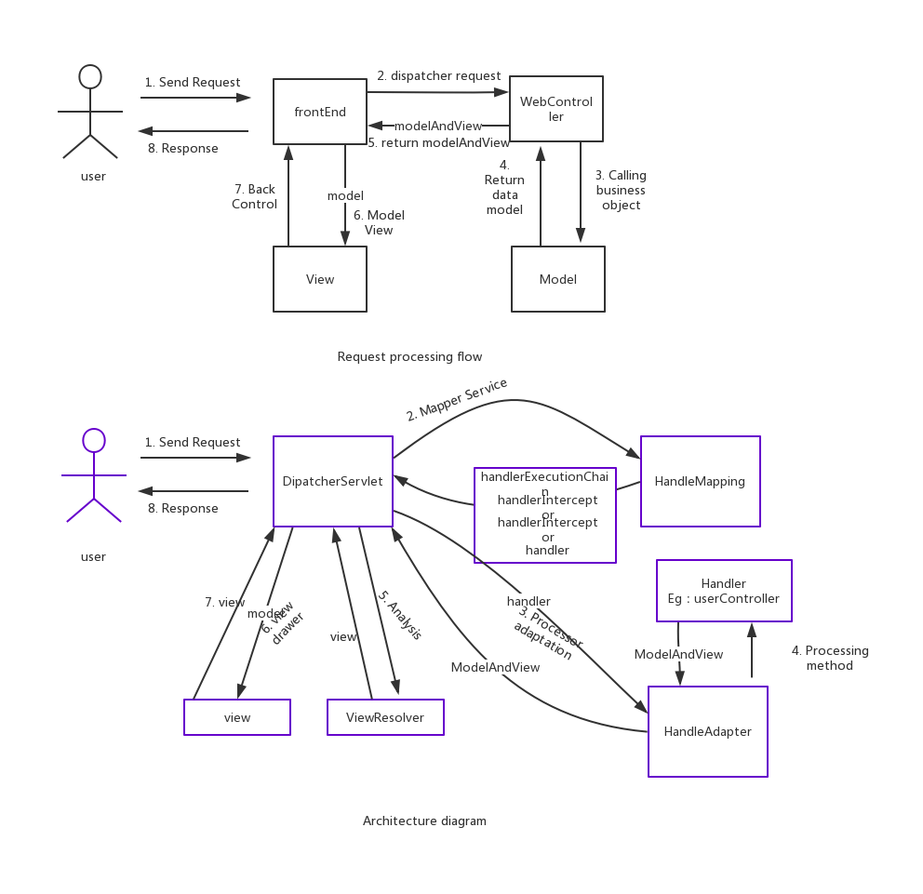
The structure of backend project

Slide 34
More interesting and useful applications of KG
Conversational recommendation system
Wellness and Dietlens
…
This project (FoodKG) and another ( DiseaseKG) are developed together. They will be connected to form a more valuable and more complex system as soon as possible

Slide 35
The Project
The github address of this KG project:
https://github.com/Daviddddl/myKG
The github address of disease KG project:
https://github.com/Daviddddl/Data_Policy_Corpus
The url of this KG project: (only in NUS)
http://172.29.34.69:7474/browser/

